Slide 1
Corporate Overview
“Transporting Information Globally”

Slide 2
Who is SCS Networks
Global End-to-End service provider focused on limited infrastructure locations
Robust satellite-centric pre-provisioned MPLS Network includes over 30 teleports and 220 Points of Presence (PoPs) supporting Any Transport over MPLS (AToM)
Our diverse and redundant MPLS Network is designed using major international partners
Full End-to-End services to include terrestrial, teleport, space segment and 24/7 NOC services

Slide 3
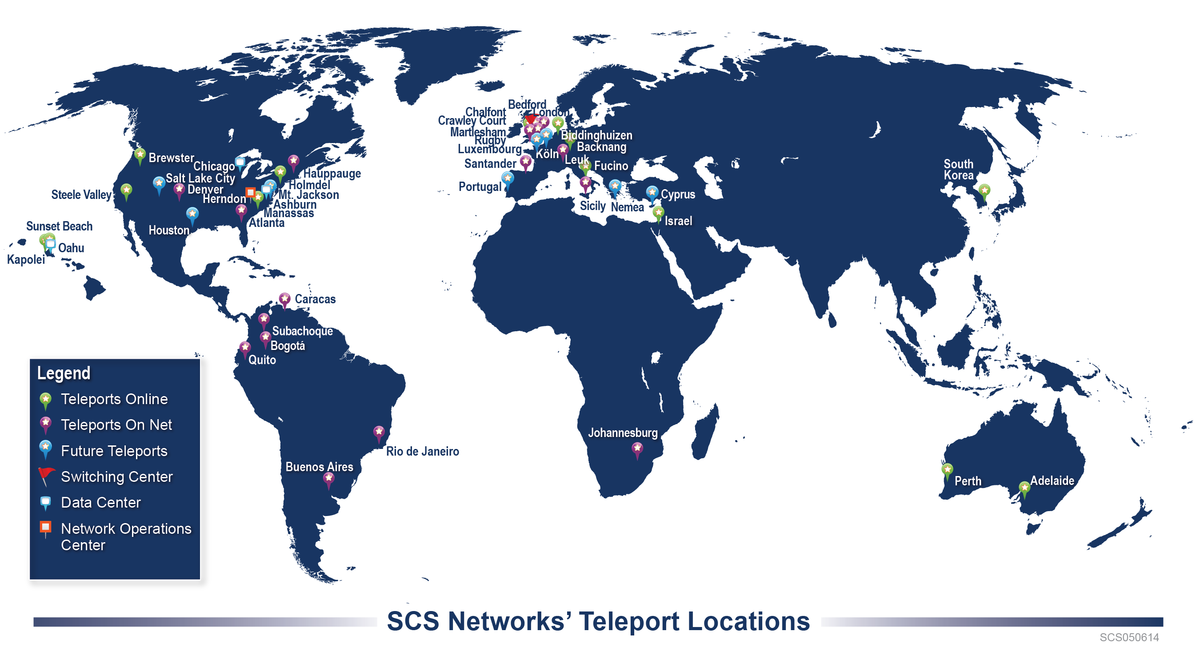

Slide 5
Active Teleports & Data Centers
Online
On Net
Kapolei, USA
Haleiwa, USA
Steele Valley, USA
Brewster, USA
Holmdel, USA
Manassas, USA
Gerrards Cross, GBR
Biddinghuizen, NLD
Ashburn, USA
Chicago, USA
London, GBR
Backnang, DEU
Emek Ha’Ela, ISR
Kumsan, KOR
Perth, AUS
Adelaide, AUS
Fucino, ITA
Denver, USA
Atlanta, USA
Hauppauge, USA
Caracas, VEN
Subachoque, COL
Bogotá, COL
Quito, ECU
Rio de Janeiro, BRA
Buenos Aires, ARG
Johannesburg, ZAF
Sicily, ITA
Crawley Court, GBR
Bedford, GBR
Martlesham, GBR
Rugby, GBR
Santander, ESP
Leuk, CHE
Legend
Teleport
Data Center

Slide 6
Short Term Bandwidth
In-place MPLS network offers a number of satellite bandwidth coverage options without regard to a specific fleet, teleport, or footprint
Pre provisioned Network allows for immediate deployment
Satellite Bandwidth confirmed with multiple vendors for Short Term (Occasional Use) availability
For the same $, receive up to 16 times the throughput as streaming BGAN

Slide 7
Secure NOC
Fully redundant 24x7x365 NOC with automatic failover
Network Management, Incident Response, Reporting
Experienced Personnel
85% have VSAT experience, iDirect training
100% are Cisco certified
70% have clearances

Slide 8
An O3b Partner
MEO: 8,062km altitude
High Bandwidth | Scalable options from 100 Mbps to 1 Gbps
High Speed | 432 MHz steerable beams 6 x faster than 72 MHz Geostationary satellite transponders
Low Latency | Roundtrip latency of <150ms enabling:
 | Faster Interactivity Superior voice quality
Low Cost | Significantly lower cost than Geostationary
Flexibility | Steerable 700km (450nm) beams can be placed anywhere w/in ±45 degrees of the Equator

Slide 9
Why SCS Networks
Feature
Benefit
Fully Operational MPLS Network
Connected to over 30 teleports
Scalability
Flexible Terms
Ease of acquisition and use
Immediate Access
Connectivity to over 220 PoPs
24/7 Monitoring and Control (M&C)
Visibility to every communications satellite
Multiple coverage options to provide services globally
1Mbps to Gigabits of throughput
Supporting occasional use or long term requirements
Solutions that accommodate any budget
Use existing terminals (no installation) to optimize your VSAT investment

